Slide 1

Computer Networks
By
Dr. Kanchan Shende

Slide 2
Module 2 : Network Models
OSI Reference Model
TCP/IP Reference Model
Comparison of OSI and TCP/IP model
Addressing : Physical, Logical and Port addresses
SoCS, MIT-WPU

Slide 3
Network Models
A network is a combination of hardware and software that sends data from one location to another.
Hardware : The hardware consists of the physical equipment that carries signals from one point of the network to another.
Software: The software consists of instruction sets that make possible the services that we expect from a network.
SoCS, MIT-WPU

Slide 4
OSI Reference Model (Bottom – Up Approach)
SoCS, MIT-WPU

Slide 5
Conti…
Understand the OSI reference model.
List various layers in the OSI reference model.
Understand how each layers interact with other layer.
SoCS, MIT-WPU

Slide 6
Conti…
What is Layering?
Layering means decomposing the problem of building a network into more manageable components (Layers).
More modular design and easy to troubleshoot.
SoCS, MIT-WPU

Slide 7
Conti…
Purpose of OSI reference model
The purpose of the OSI model is to facilitate communication between different system without requiring changes to the logic of the underlying hardware and software.
SoCS, MIT-WPU

Slide 8
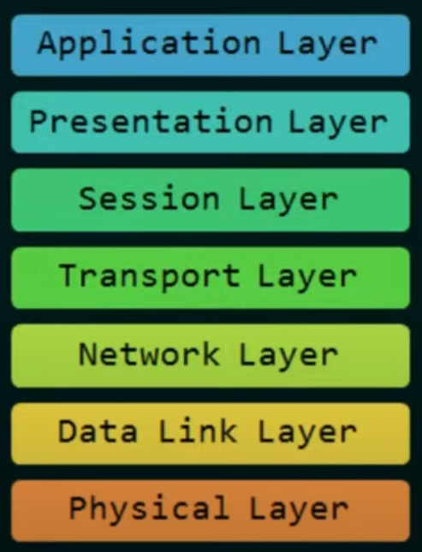
Conti…
Layers in the OSI reference Model
SoCS, MIT-WPU

Slide 9
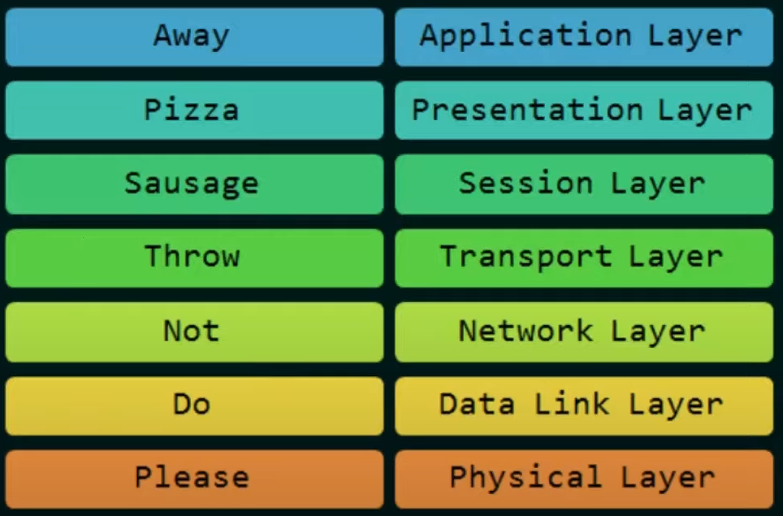
Conti…
SoCS, MIT-WPU

Slide 10
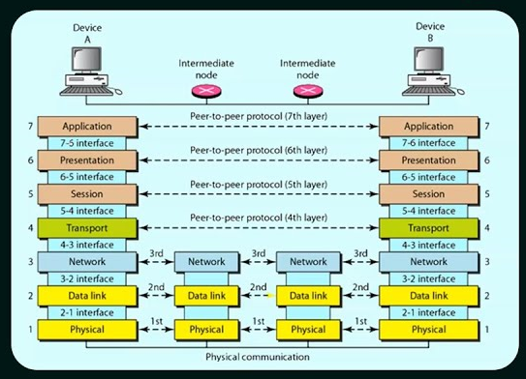
Conti…
SoCS, MIT-WPU

Slide 11
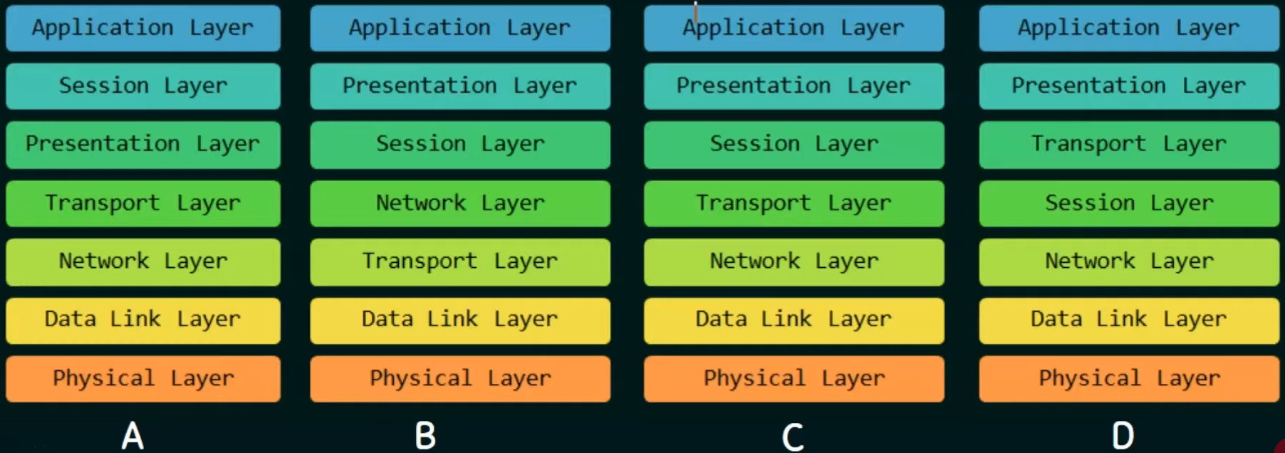
Conti…
SoCS, MIT-WPU

Slide 12
Conti…
Application Layer
My password is mitwpu@1234#
Presentation Layer
odfkdmd*fypp1#
Session Layer
odfkdmd*fypp1#
Transport Layer
TL-INFO odfkdmd*fypp1#
Network Layer
NL INFO - TL-INFO odfkdmd*fypp1#
Data Link Layer
DL INFO - NL INFO - TL-INFO odfkdmd*fypp1#
Physical Layer
101010010001010100001010101010
SoCS, MIT-WPU

